Slide 1

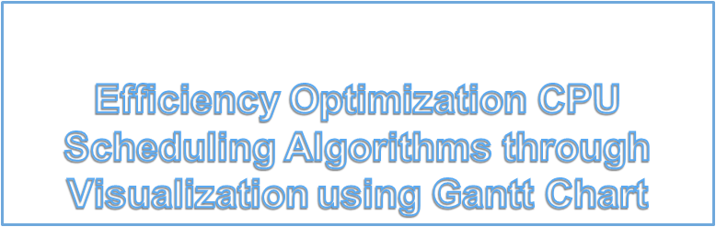

Slide 2



TEAM MEMBERS
Ishtia Gupta
Geetanjali Purohit
Harsh Kumar
Contact lead at:ishitagupta19@gnu.ac.in
Ganpat University,Ahmedabad (B.tech CSE Sophomore)

Slide 3
Problem Definition
Efficiency Optimization CPU Scheduling Algorithms through Visualization Using Gantt Charts. A prototype approach for healthier comparison and analysis

Slide 4
Breif of why our project is important?
Visualization of the discovered patterns is important in order to communicate information efficiently and quickly using tables, charts, rules, decision trees etc hence our aim was to create a prototype which can Visualize the different algorithms and can compare the Efficiency of the Algorithms By analyzing the patterns using the same data set through Gantt Charts.
Scheduling is a key concept in computer multitasking and multiprocessing operating system design, and in real-time operating system design. CPU scheduling is the basis of multiprogramming operating systems by switching the CPU among process; the operating system can make the computer more productive, scheduling algorithms are widely used in communications networks and in operating systems to allocate resources to competing tasks.

Slide 5
1
Exsisting Work and Literature Review
Let’s analyze the current situation

Slide 6
CPU Scheduling and visualization research
-There are no exsisting models currently available which display complete algorithmic calculation as well as proper visualization of gantt charts .
-Research concludes that visualization helps teachers to efficiently convey concepts to students(See references)
-Researchers get a basic bolier plate code to work on and test their algorithm
-One stop platform for comparison of efficiency algorithms for best visual comparisson.

Slide 7
Citations/References- More available in text doc
(main ones listed)
APPLYING VISUALIZATION FOR TEACHING SCHEDULING ALGORITHMS IN COMPUTER SCIENCE
http://dspace.calstate.edu/bitstream/handle/10211.3/189281/AlkhazlFatimah_Project2017.pdf?sequence=4
USING VISUALIZATION TO UNDERSTAND THE BEHAVIOR OF COMPUTER SYSTEMS
https://graphics.stanford.edu/papers/bosch_thesis/bosch_thesis.pdf
A comparative Review of CPU Scheduling Algorithms
https://www.researchgate.net/publication/276205562_A_Comparative_Review_of_CPU_Scheduling_Algorithms#:~:text=CPU%20scheduling%20deals%20with%20the,the%20performance%20of%20real%20applications.

Slide 8
How simulation works ?
A simulation uses a mathematical description, or model, of a real system in the form of a computer program.
It involve running a gamut of mathematical scenarios to determine the potential scope or impact said scenario could have.

Slide 9
Our Logic and Project details
We are performing the simulation for CPU scheduling in Operating System, where you can see animated charts and calculated values for the scheduling.
CPU Scheduling in Operating System includes many types of schedulings like :
(1) First Come First Served
(2) Shortest Job First
(3) Round Robin Scheduling
(4) Longest Job First
(5) Highest Response Ratio First

Slide 10
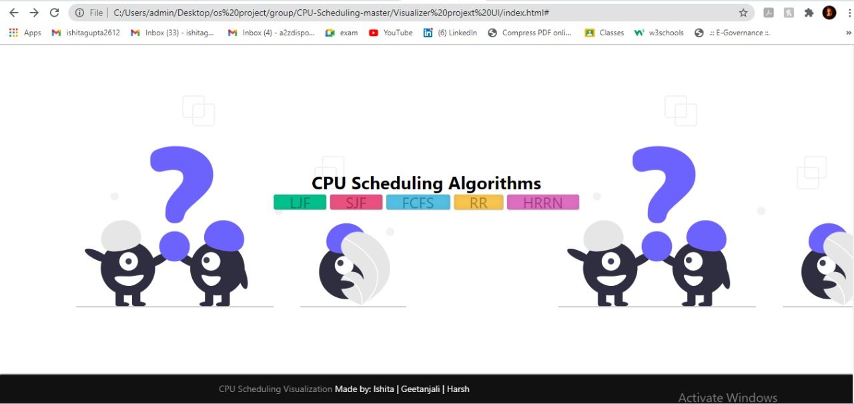
Outputs Of Project(Easy to Use UI for usage effciency)

Slide 11
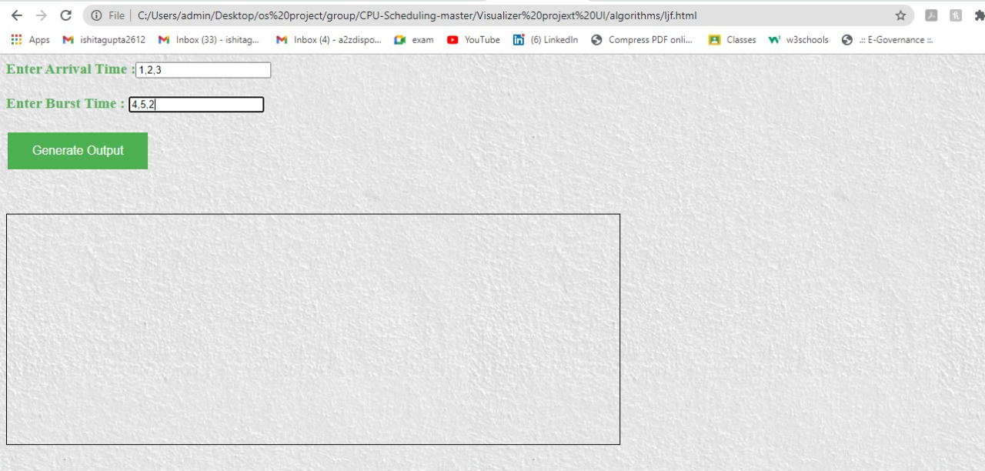

Slide 12
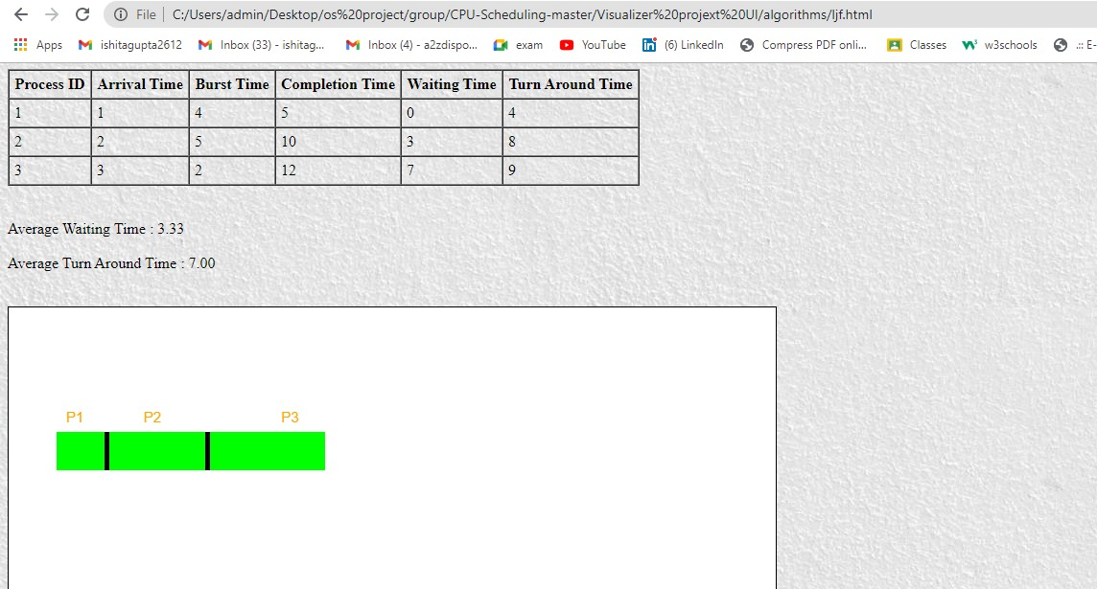
Here is an example of longest job first of CPU Scheduling in Operating System

Slide 13
Possible Future Expansions
Our Project is simply a prototype which we are planning to expand to a larger scale to indulge more research work on hybrid algorithms(such as combining the FCFS and SJF algorithms to create a new algorithm)
We are planning to add more algorithms into our project such as priority preemptive and non- preemptive process scheduling to expand our area of reach.
Planning to secure the code base from user interface by adding a server into the project.
We are planning to use this prototype as a boilerplate for research analysis for comparing the efficiency of the different algorithms using the same data sets through Gantt Charts

